Slide 1
Data Visualization Data-Driven Analysis of Air Quality in Beijing

Slide 2
Dataset
Beijing past 120 months daily average AQI (Air Quality Index)
Source: Beijing Environmental Protection Monitoring Center

Slide 3
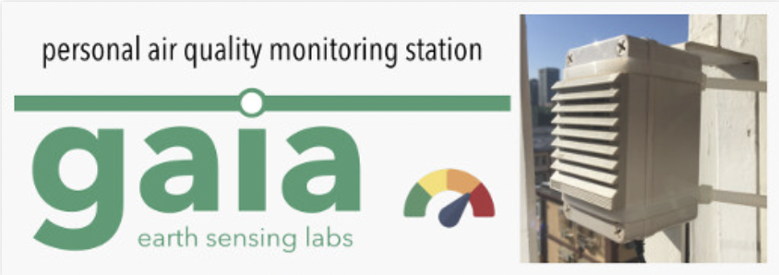
How is the data collected?
The GAIA air quality monitor uses laser particle sensors to measure PM2.5 and PM10 particle pollution in real-time
Very easy to set up, it only requires a WIFI access point and a USB power supply. Once connected, air pollution levels are reported instantaneously and in real time on our maps.
It comes fully equipped with water-proof cables, mounting tools, power supply and an optional solar panel.

Slide 4
Specifics about the Dataset
This dataset consolidates the daily air quality metrics for Beijing, covering the timeframe from dates
January 1, 2014 - December 3, 2023 (Updates frequently)
It provides granular detail on concentrations of key pollutants, including PM2.5, PM10, nitrogen dioxide (NO2), sulfur dioxide (SO2), and carbon monoxide (CO), which are instrumental in calculating the daily Air Quality Index (AQI) values.
Particulate Matter (PM), which includes PM2.5 (2.5 micrometers or smaller) and PM10 (10 micrometers or smaller), refers to tiny particles or droplets in the air.
PM2.5 is finer and PM10 is larger, with PM2.5 being potentially more harmful to health.
This data enables an in-depth analysis of air pollution trends, offering insights into environmental changes and the impact of policy measures over the past decade.

Slide 5
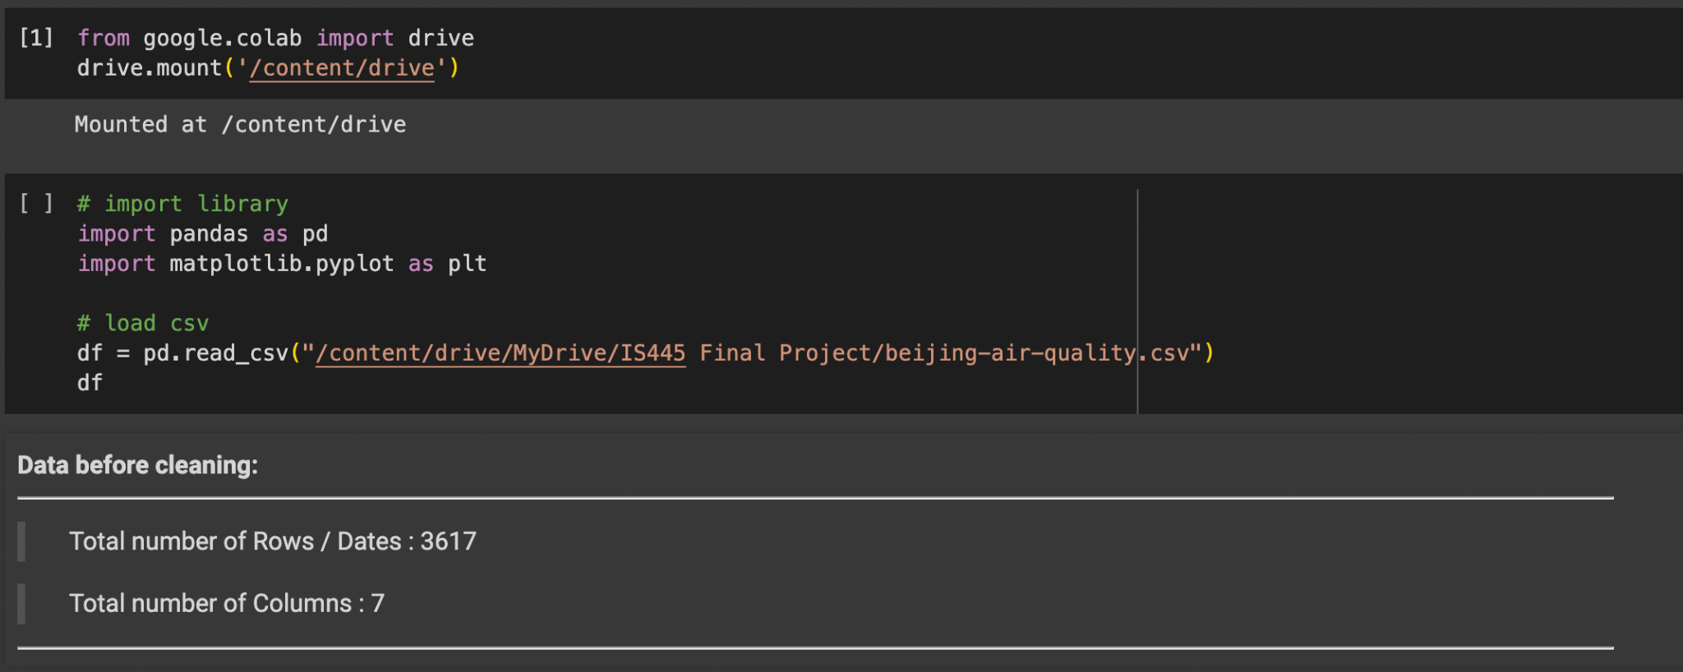
Data Entries

Slide 6
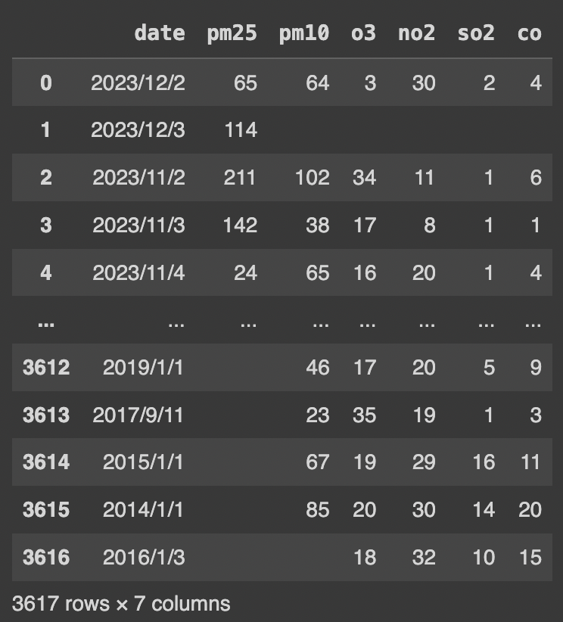
Data Entries
Columns:
Date
Pollutants:
PM25 - Particulate matter 25 (2.5 micrometers or smaller)
PM10 - Particulate matter 10 (10 micrometers or smaller)
03 - Ozone
NO2 - Nitrogen dioxide
SO2 - Sulfur dioxide
CO - Carbon monoxide
Rows:
3,617 daily records out of a possible 3,623 days,
with a 99.83% capture rate

Slide 7
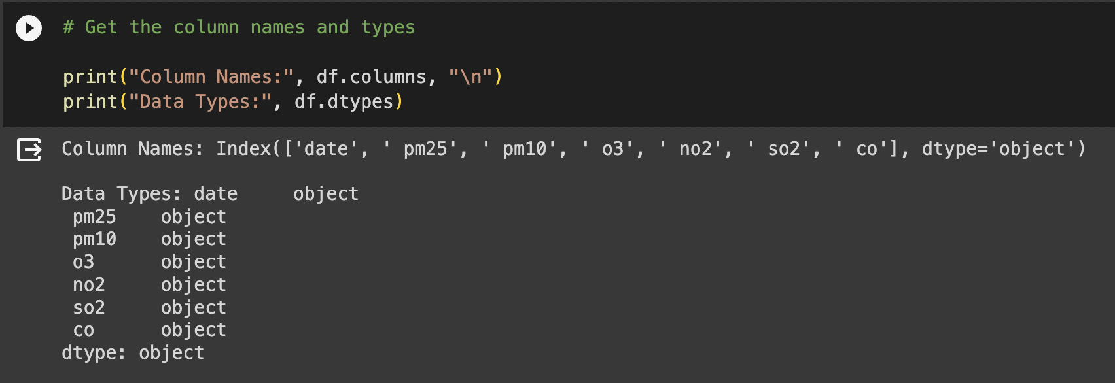
Data Preprocessing
Checking the column names and data types
Remove spaces and any other non-standard characters in the column names to ensure consistency.
Convert the data types of the columns to the appropriate data types, specifically:
Convert 'date' column to datetime for better date-time manipulation.
Convert pollutant measurement columns to float to enable numerical analysis.

Slide 8
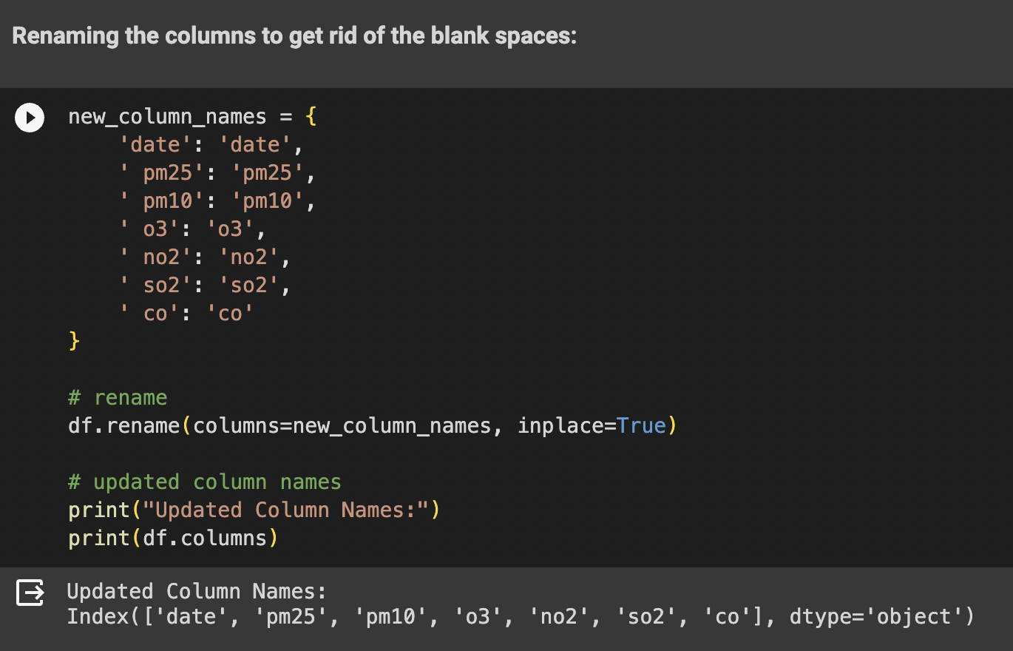

Slide 9
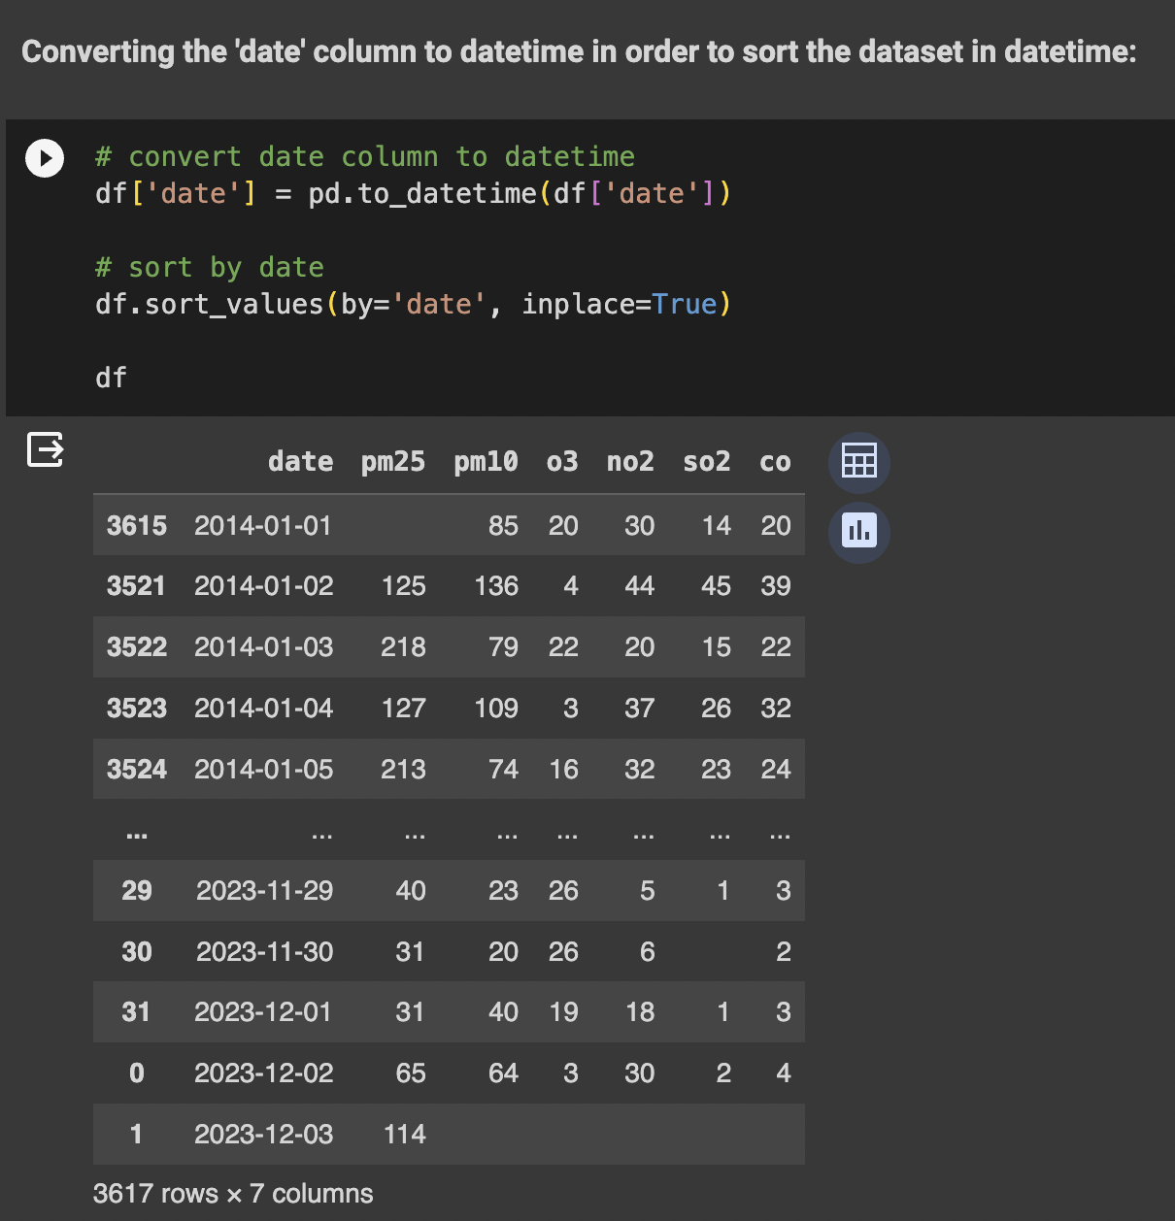

Slide 10
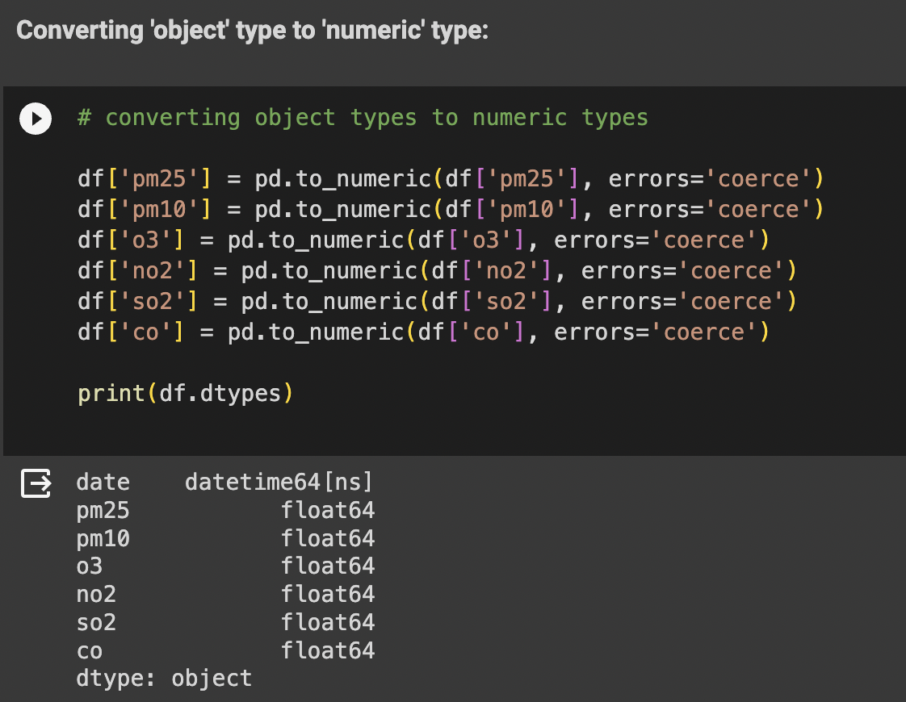

Slide 11
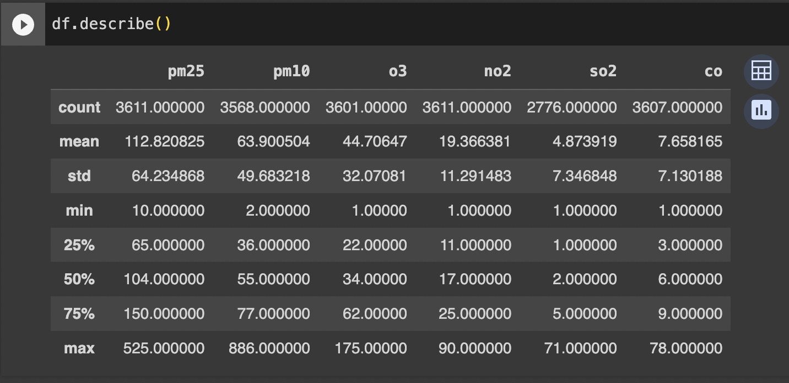
Descriptive Statistics
Checking the column names and data types

Slide 12
Descriptive Statistics Analysis
Count Variations: Some missing values are noted, with SO2 having fewer observations. This could affect the robustness of average calculations and other statistics.
Variability: The standard deviation is high for PM25 and PM10, pointing to daily fluctuations in their levels. These variations could be influenced by multiple factors such as weather conditions, economic activity, and emission controls.
Average Levels: PM25 and PM10 have the highest mean concentrations, indicating a potential concern for particulate matter pollution. These pollutants can have significant health impacts, especially PM25, which can penetrate deep into the lungs.
Range: The minimum and maximum values show a broad spread of pollution levels, with peak values for PM25 and PM10 suggesting occasional very poor air quality days.
Quartiles: The 25%, 50% (median), and 75% values demonstrate that half of the observed days fall within a moderate to potentially unhealthy range for PM25, highlighting a regular exposure to higher pollution levels.

Slide 13
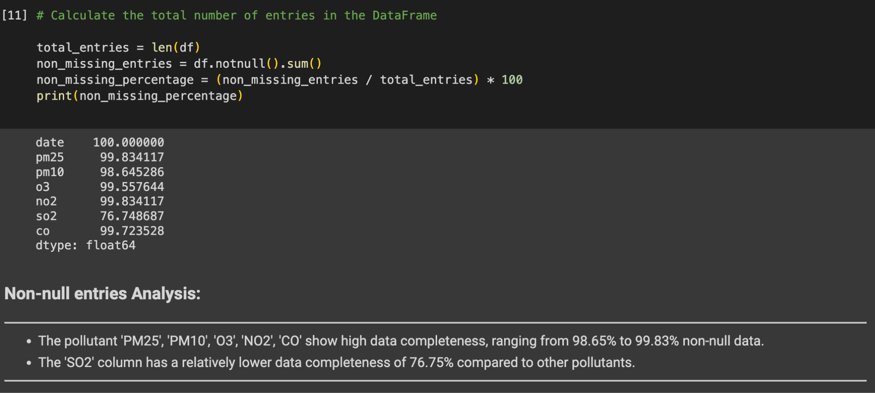
Non null values

Slide 14
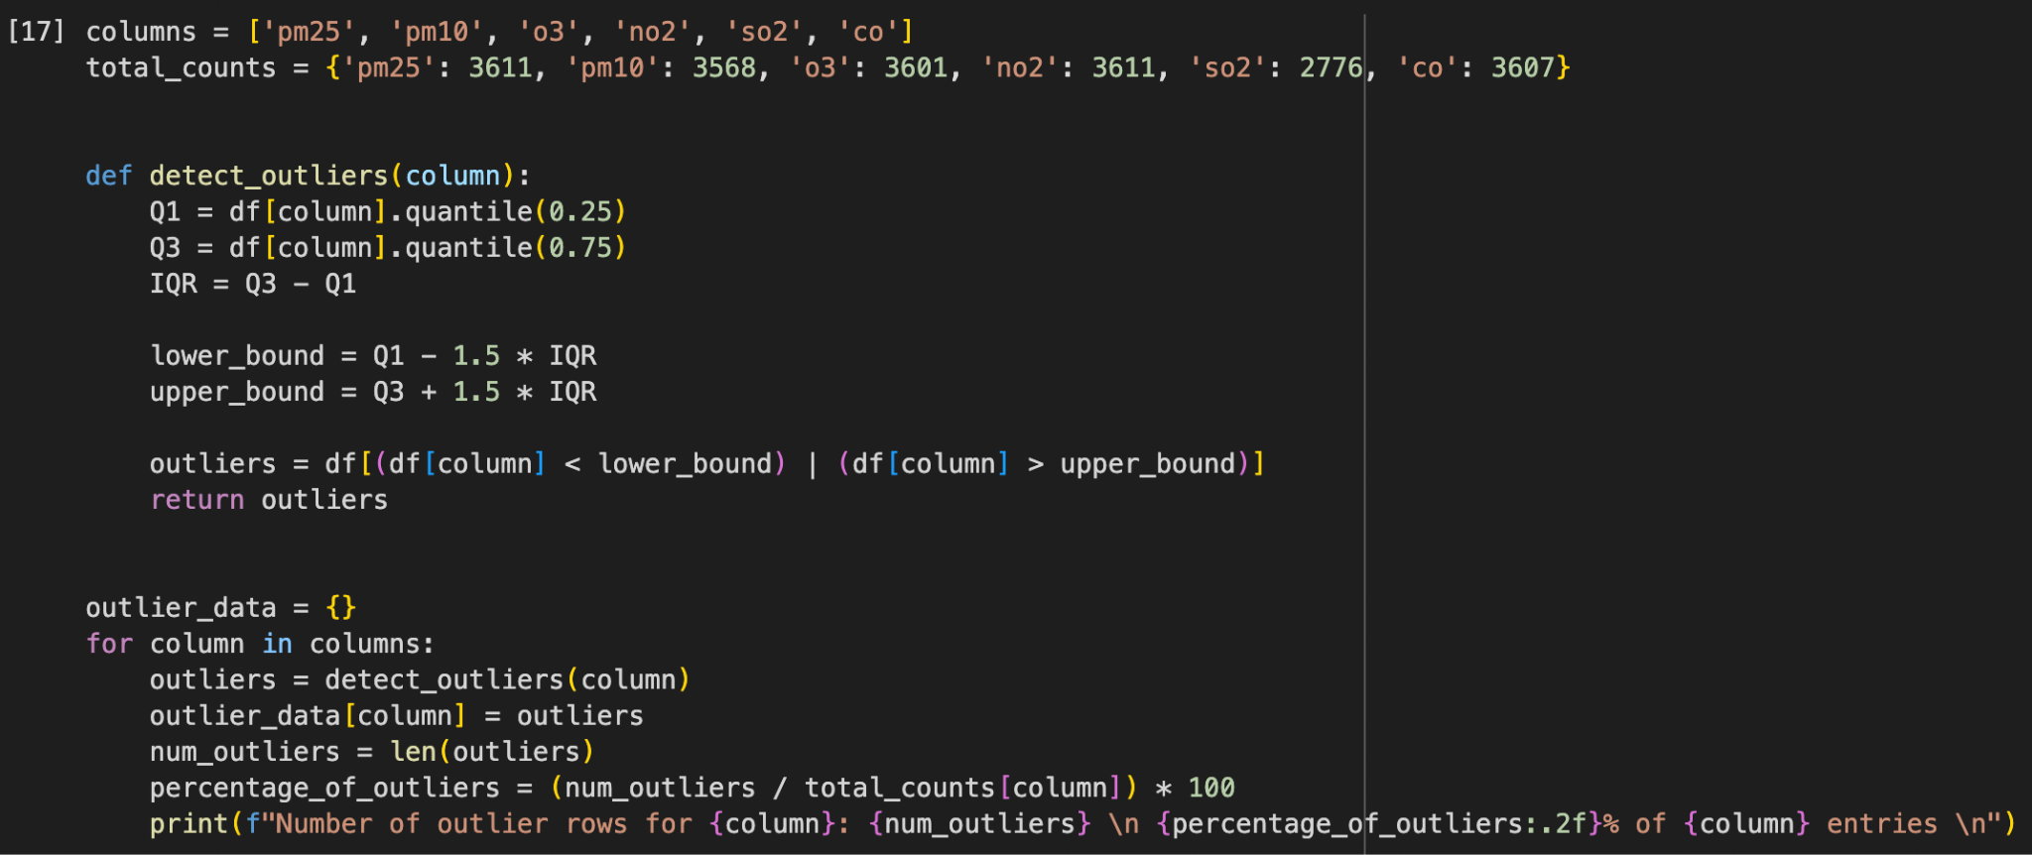
Outliers
Using the IQR, outliers would be days with extremely low or high pollution levels, which may be linked to specific environmental events or anomalies in data collection.

Slide 15
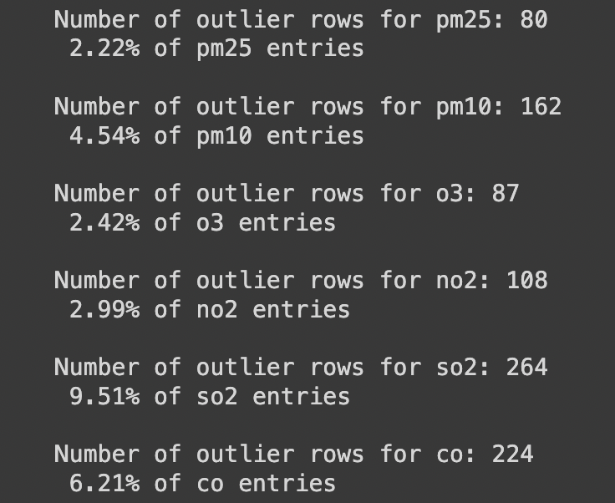
Outliers per pollutant

Slide 16
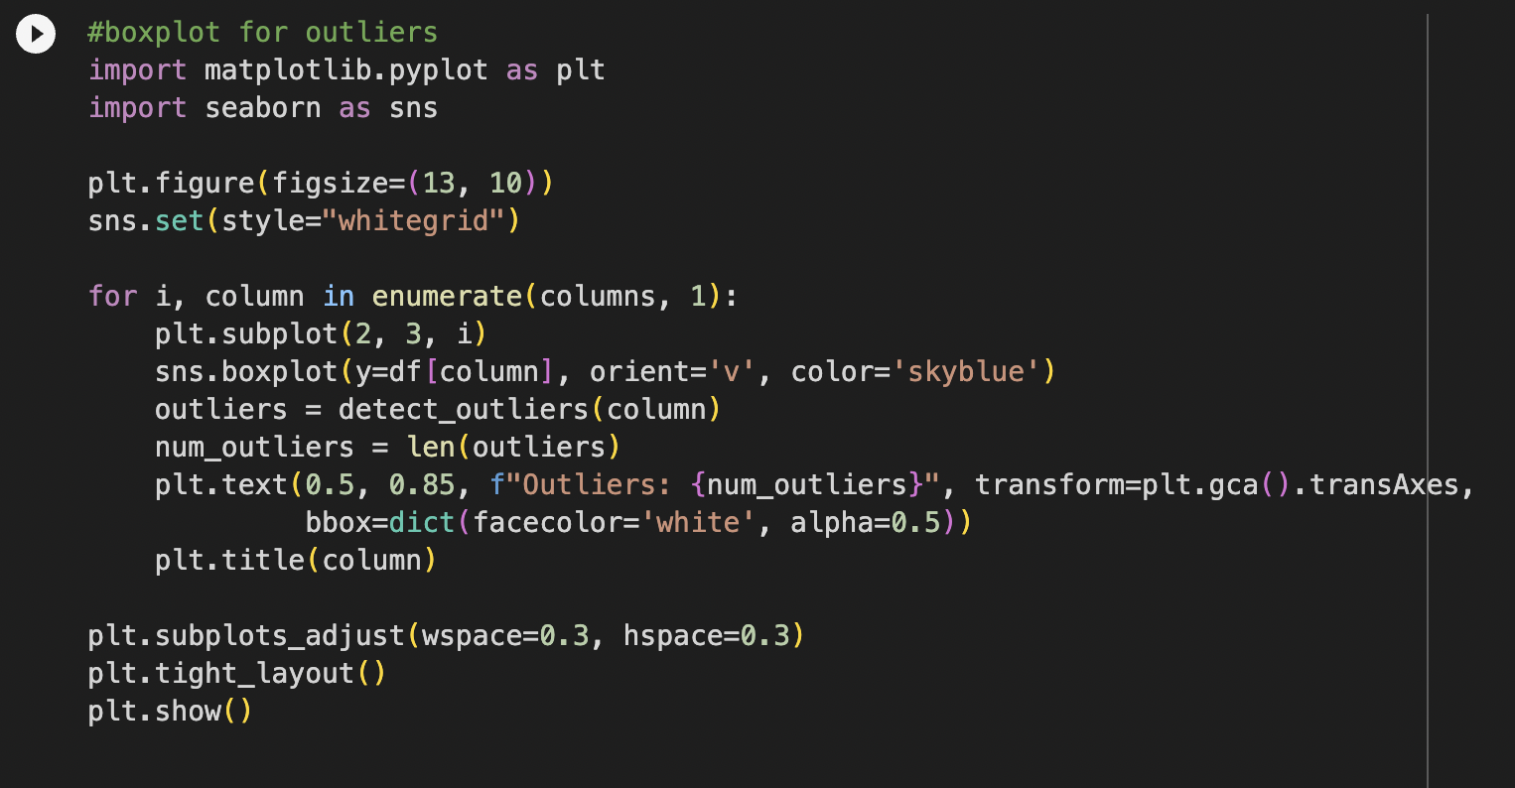
Plotting Outliers - Boxplot

Slide 17
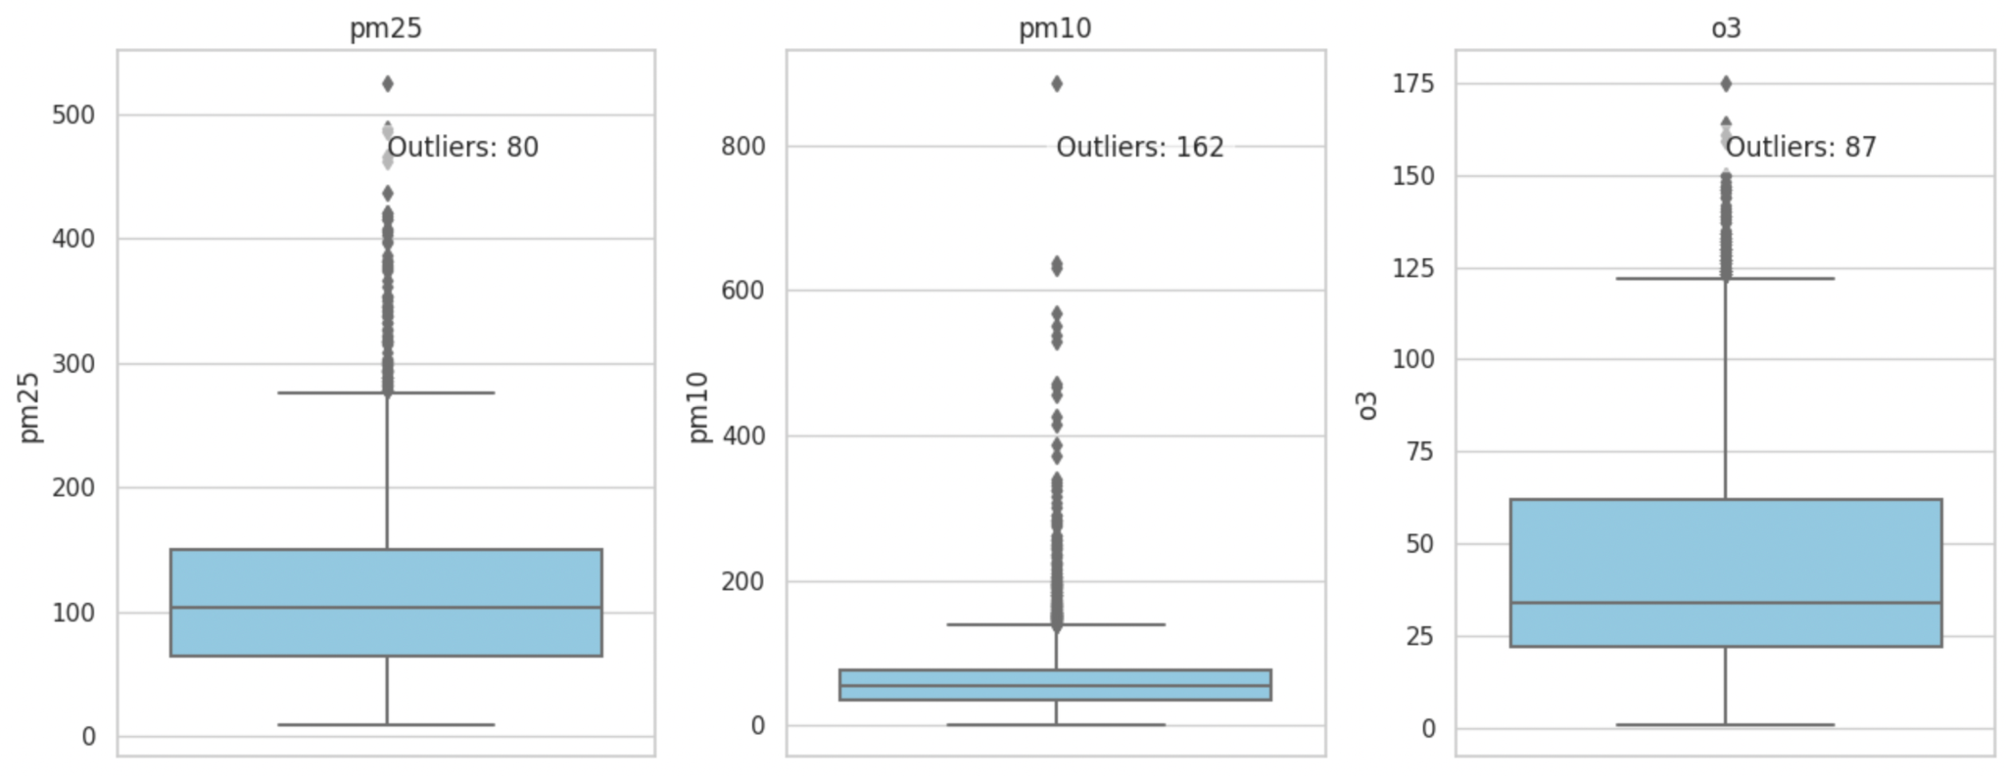
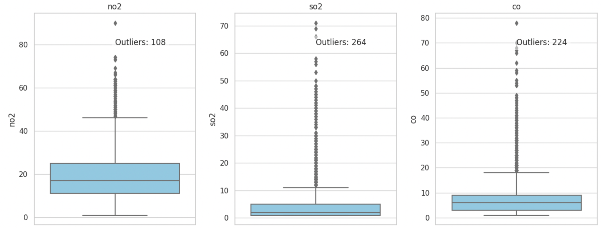

Slide 18
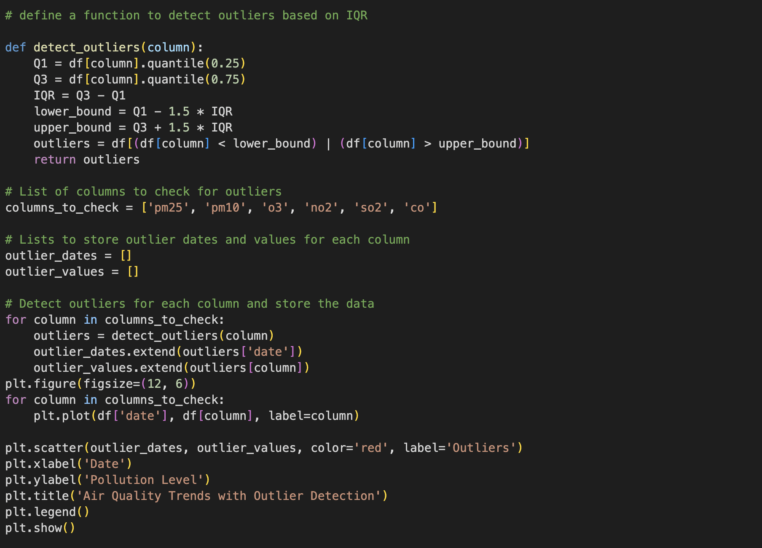
Plotting Outliers - Time Series

Slide 19
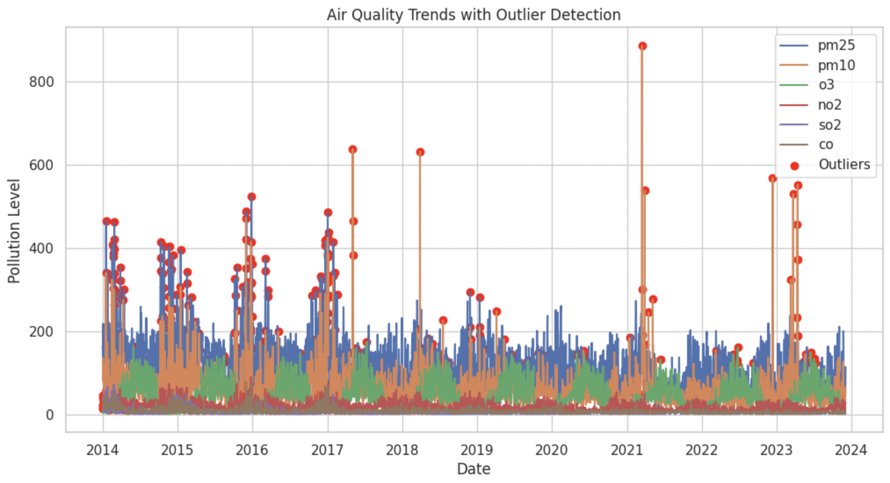

Slide 20
Outliers Analysis
PM2.5: 2.22% outlier measurements suggest occasional but severe spikes in fine particulate pollution, likely from combustion sources or adverse meteorological conditions.
PM10: With 4.54% outliers, these data points suggest that Beijing experiences more frequent extreme levels of coarser particles, possibly due to dust, construction, or industrial activities.
O3: 2.42% outliers in ozone levels could correspond to days with intense sunlight and stagnant air, conditions that enhance O3 formation, impacting urban air quality.
NO2: The 2.99% outliers for nitrogen dioxide indicate periodic and possibly localized events of high NO2, often related to traffic congestion and industrial emissions.
SO2: The high number of SO2 outliers (9.51%) highlights the potential for sporadic, significantly elevated levels, potentially from coal burning or industrial processes.
CO: 6.21% outlier readings for carbon monoxide imply instances of notably poor combustion efficiency, likely from heating systems, vehicles, or industrial activities in the city.

Slide 21
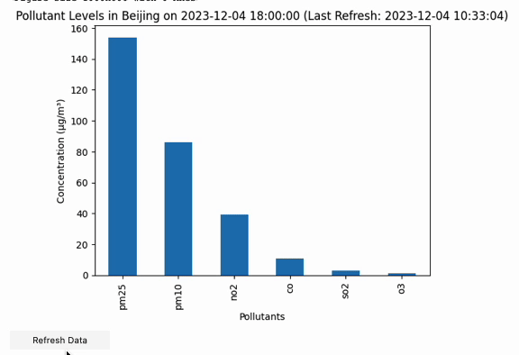
API
Refresh button enabling data updating
The time when the data was refreshed will be shown on the top of the chart.

Slide 22
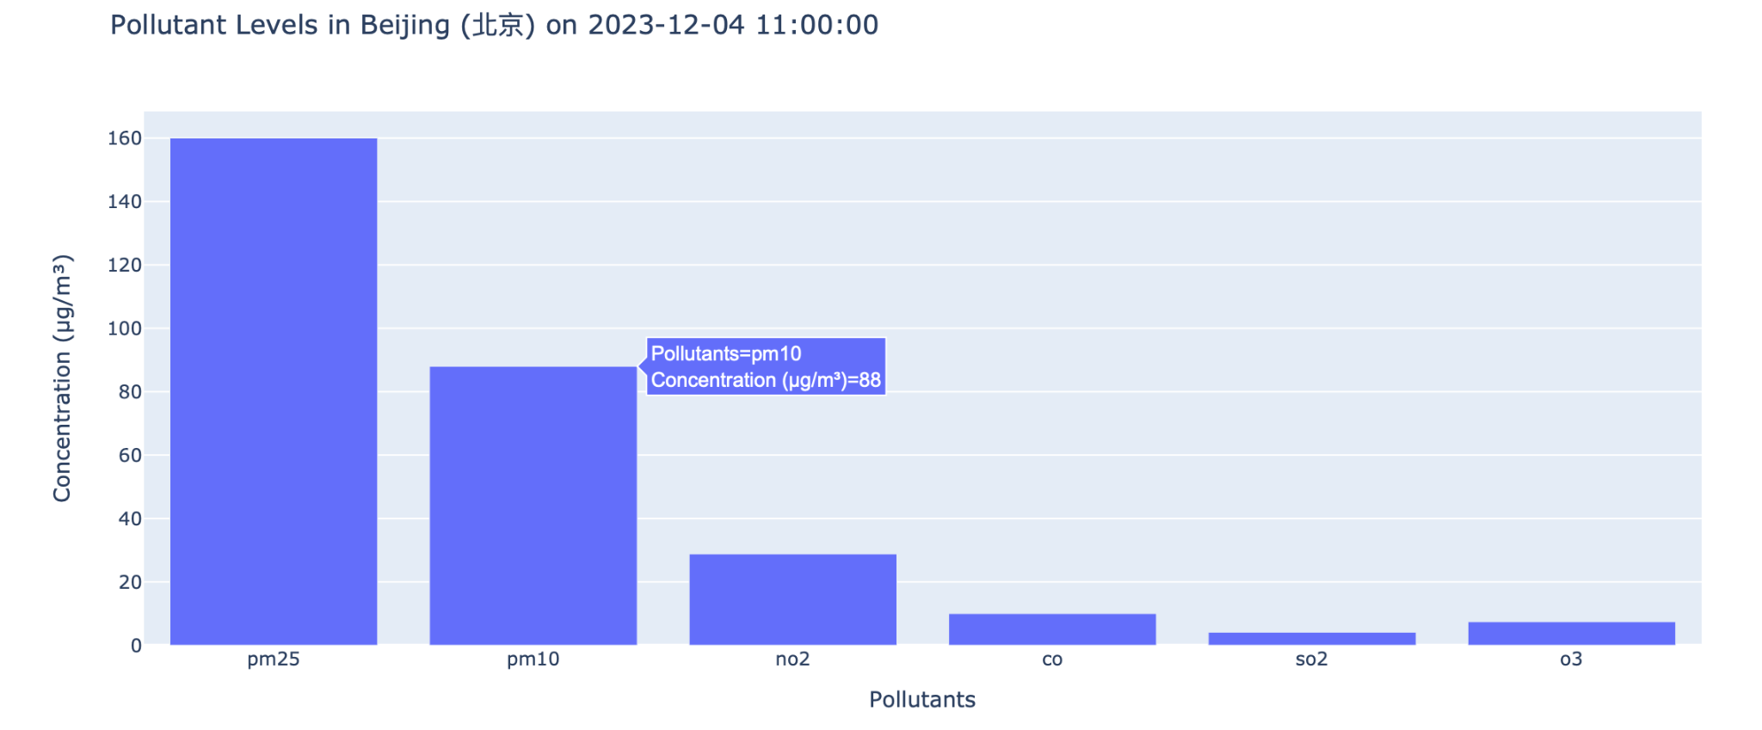
API
Interaction bar chart
View data in greater detail by framing specific areas.

Slide 23
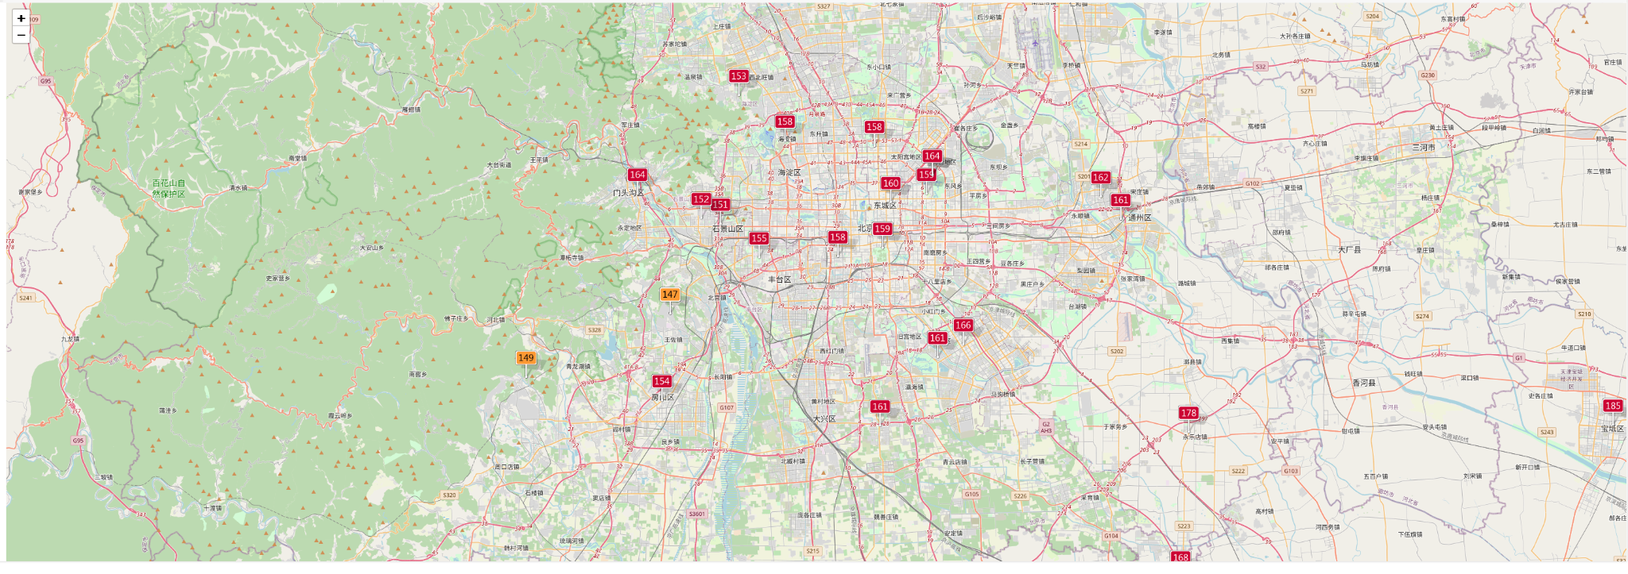
API
Map Tile
Show the real-time Air Quality index on a google, bing or openstreetmap.

Slide 24
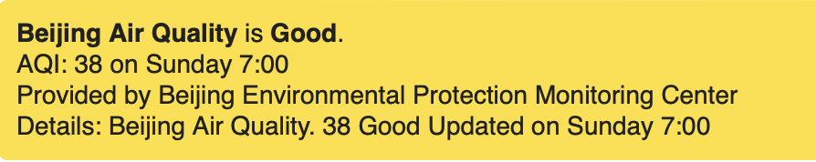
API
Widget
Sample Data showing the category
Data from API not able to show category

Slide 25
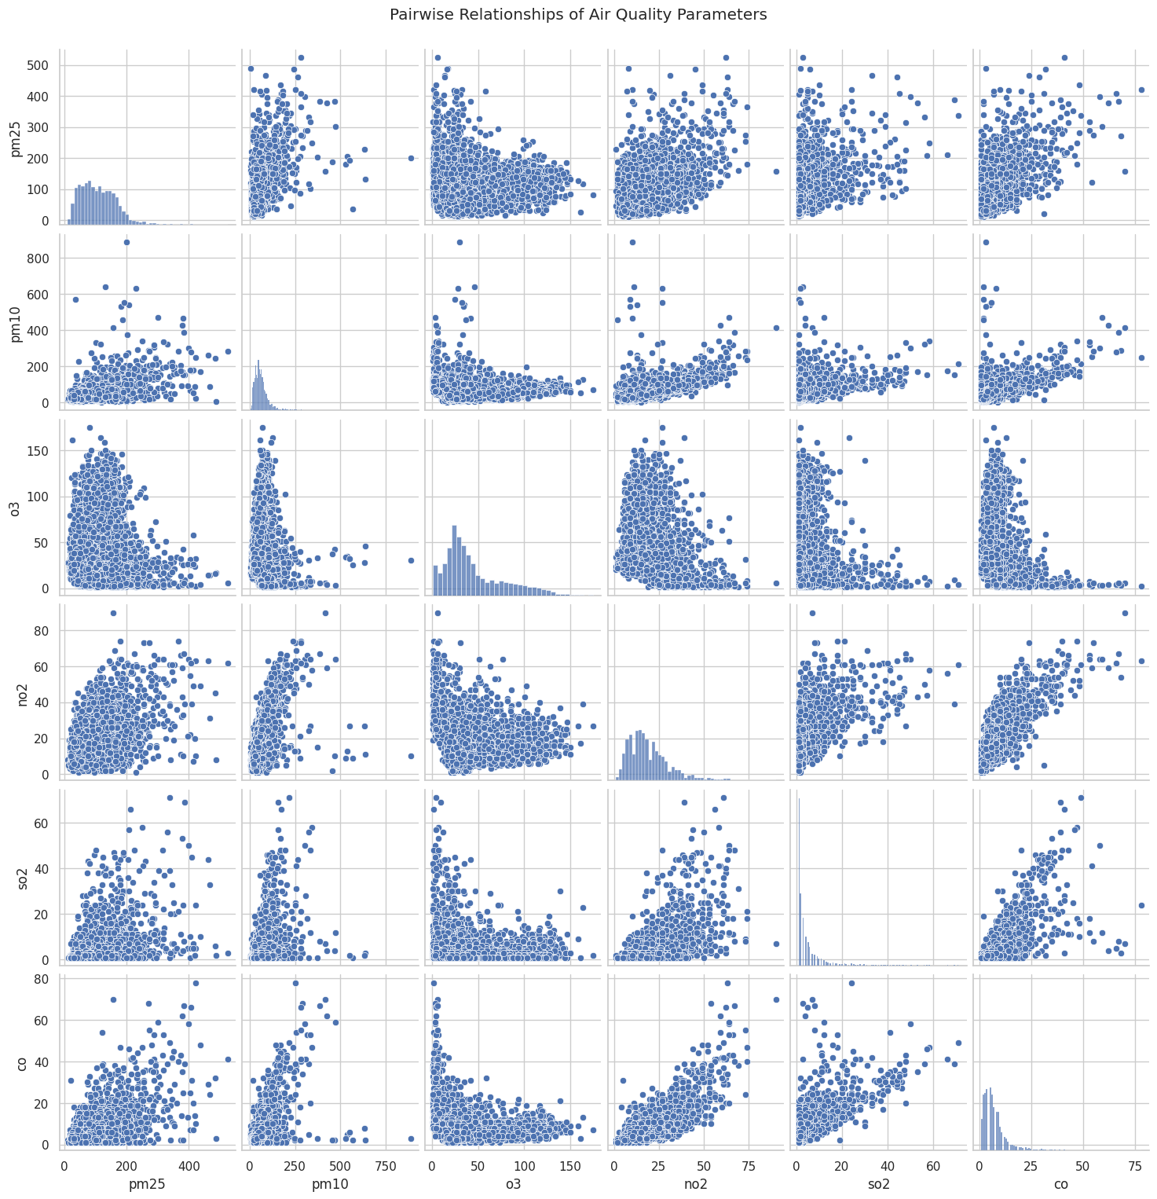
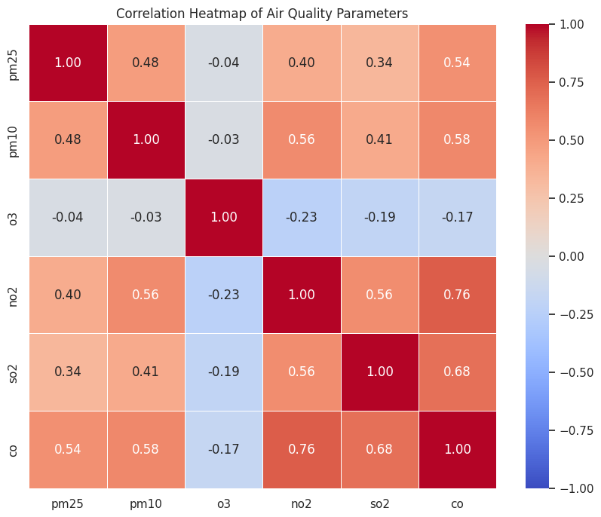
Pair Plot
Heat Map
Correlation
Notes:
Xuhan Zhang

Slide 26
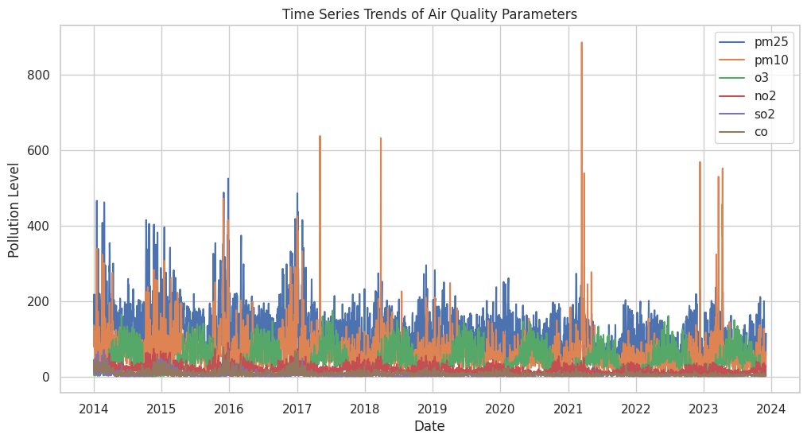
Trends
Looks too squeezed up
Notes:
Xuhan Zhang

Slide 27
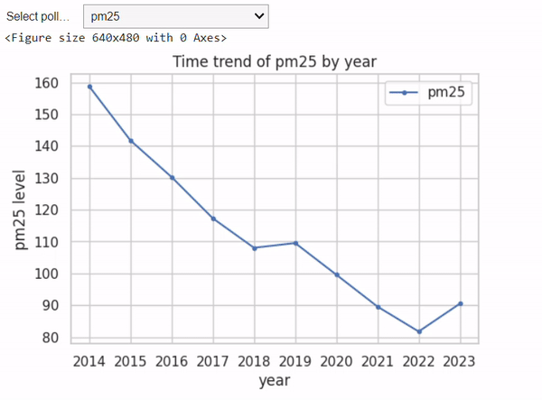
Trends
Time trend of each pollutant by year
Notes:
Xuhan Zhang

Slide 28
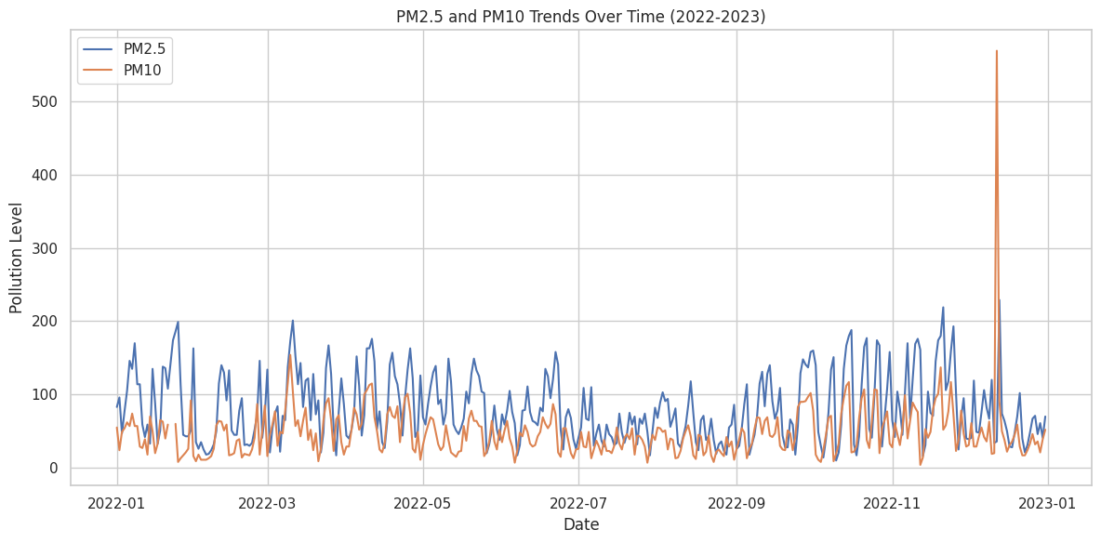
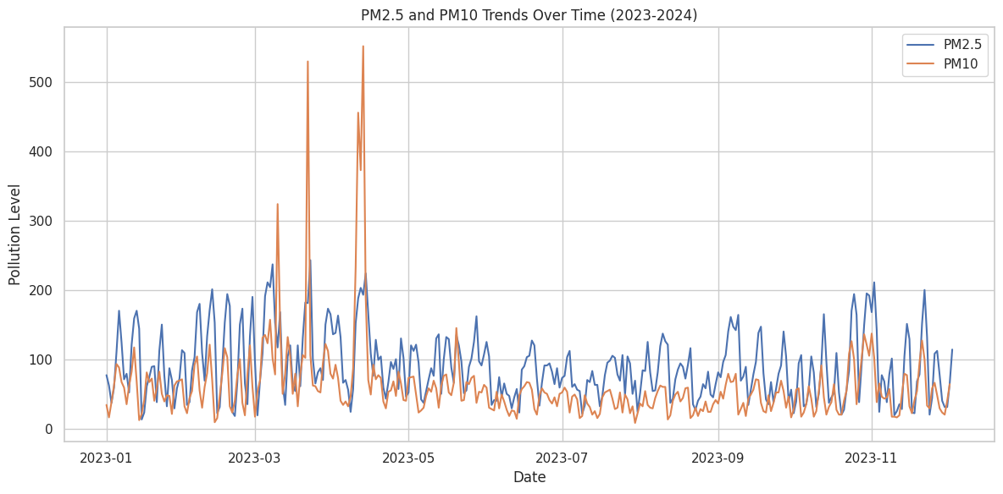
In 2022
In 2023
Trends
PM 2.5 and PM 10 Trends Over Time
Notes:
Xuhan Zhang

Slide 29
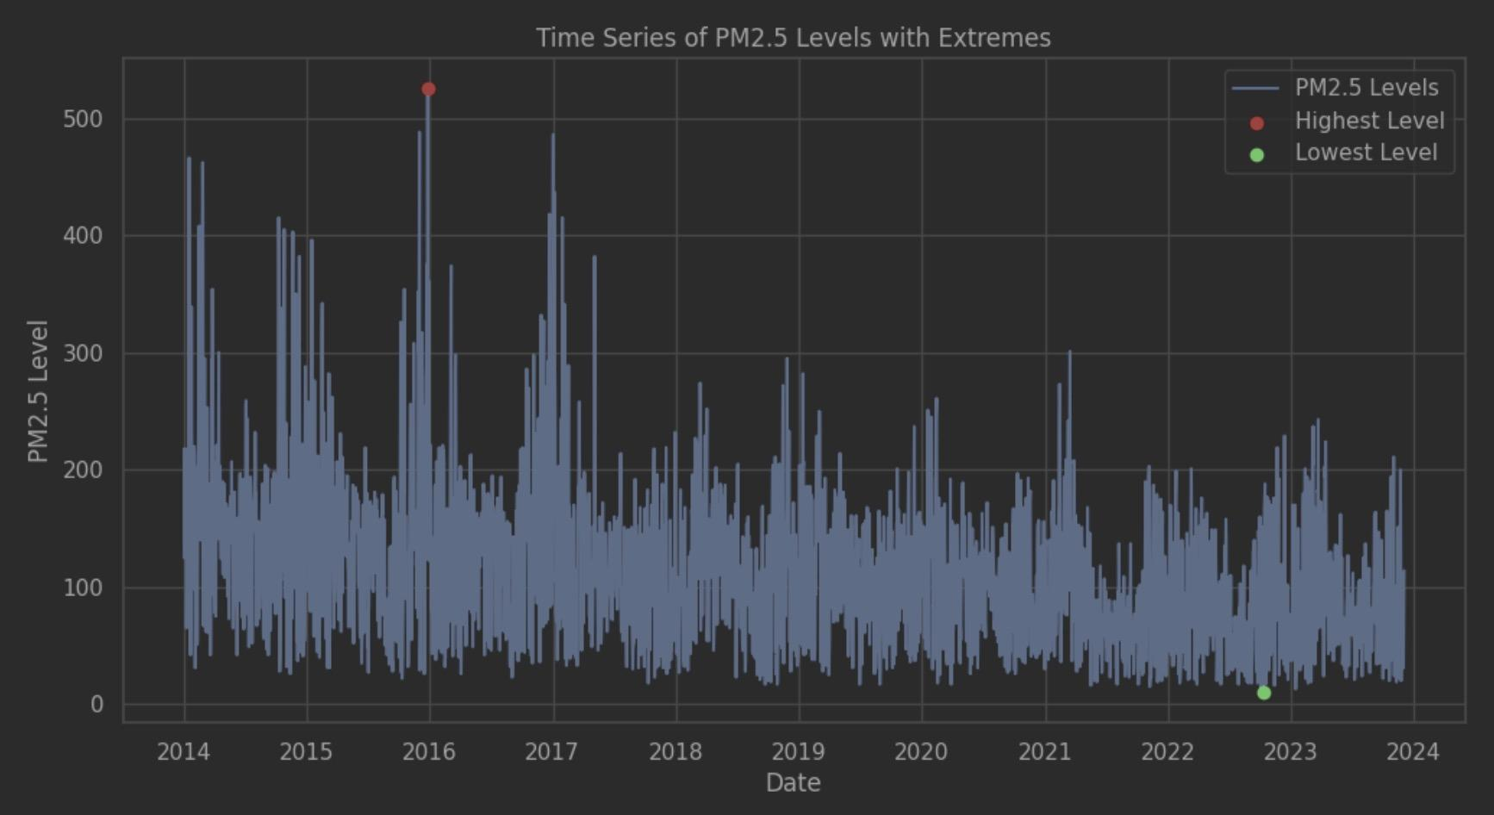
Monthly, Seasonal and Year Pattern
2014 ~ 2024

Slide 30
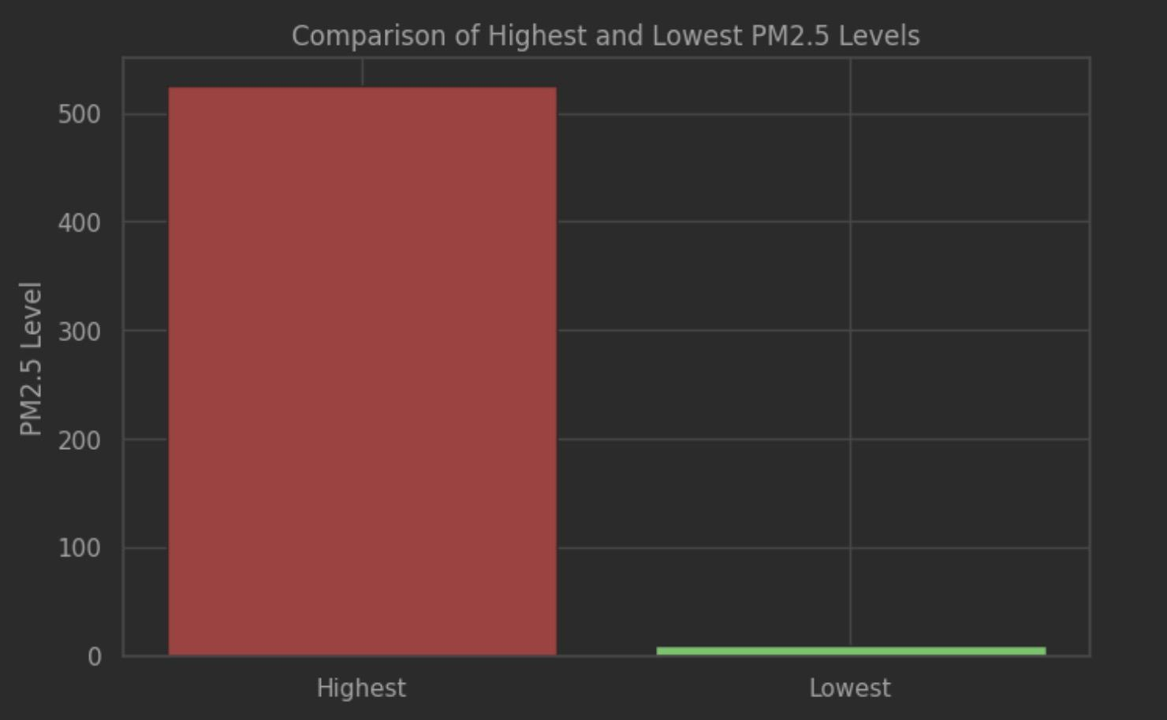
Comparison of the highest and lowest PM 2.5 Level

Slide 31
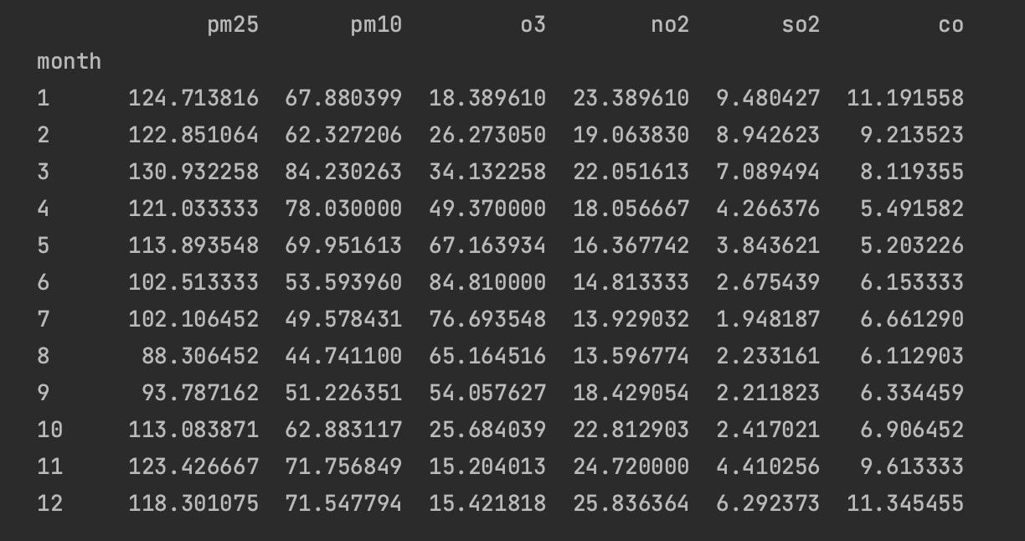
Across different month

Slide 32
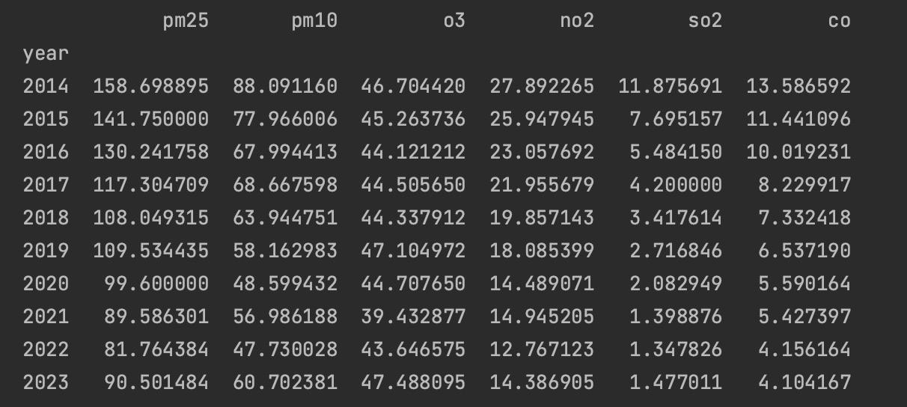
By year

Slide 33
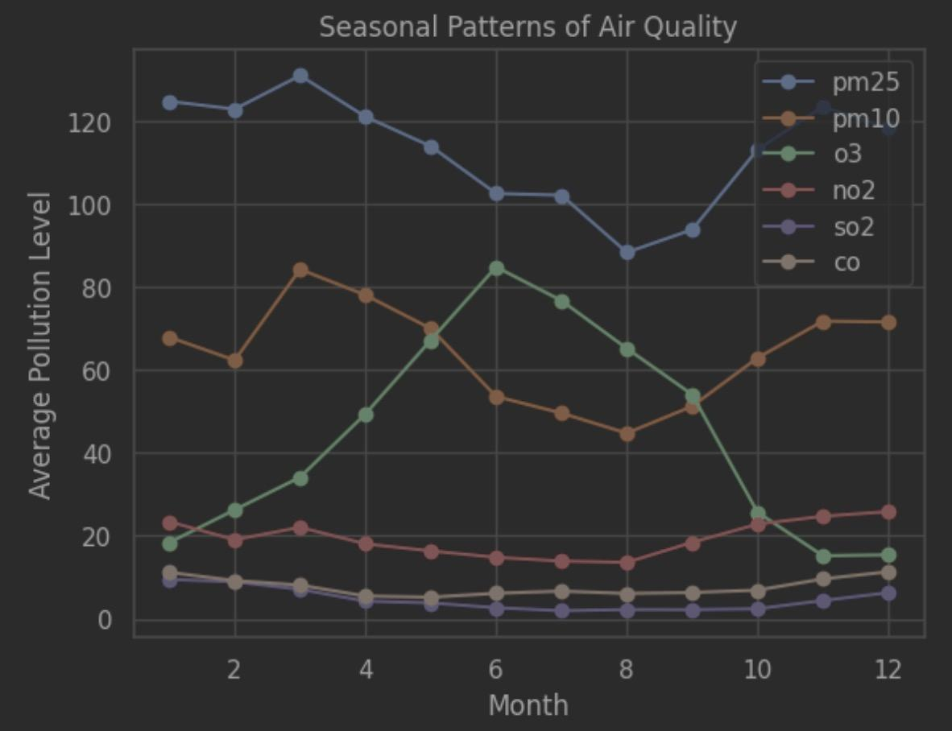
Seasonal patterns of Air Quality

Slide 34
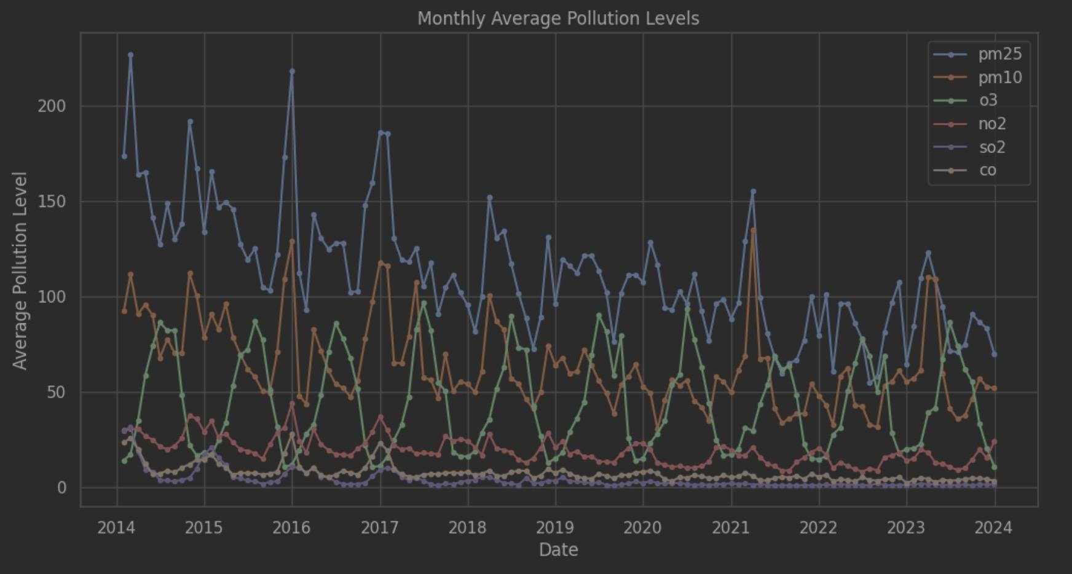
Monthly average Pollution Levels

Slide 35
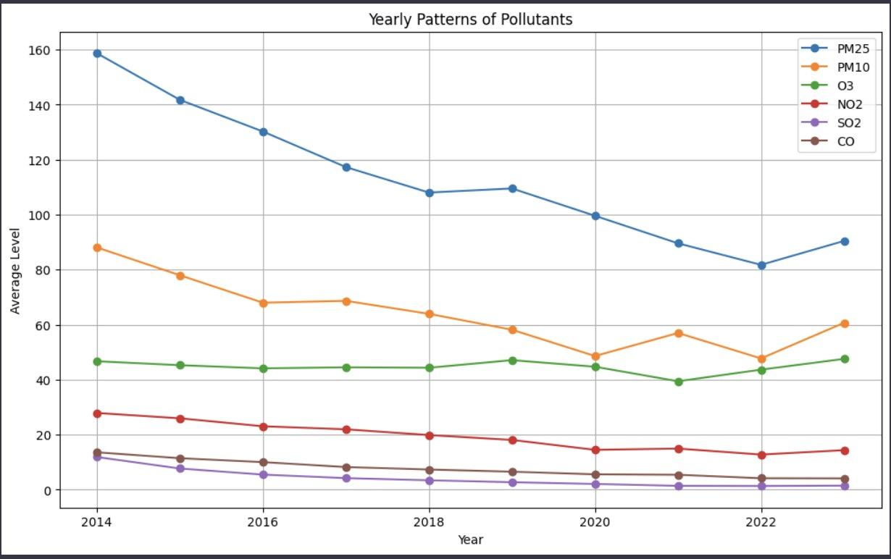
Yearly patterns of Air Quality

Slide 36
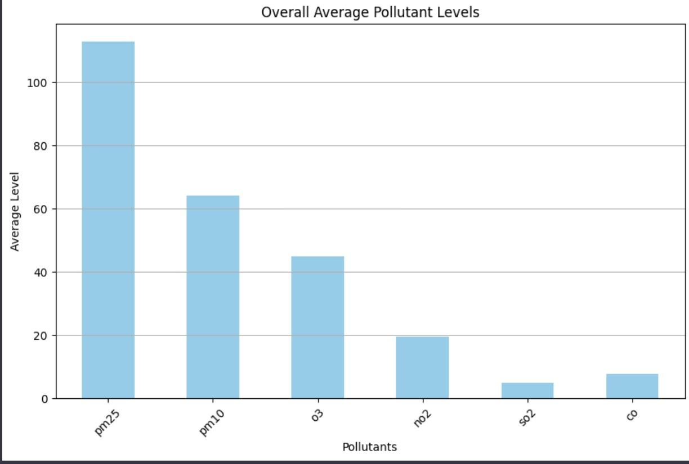
Overall Average Pollutants Levels

Slide 37
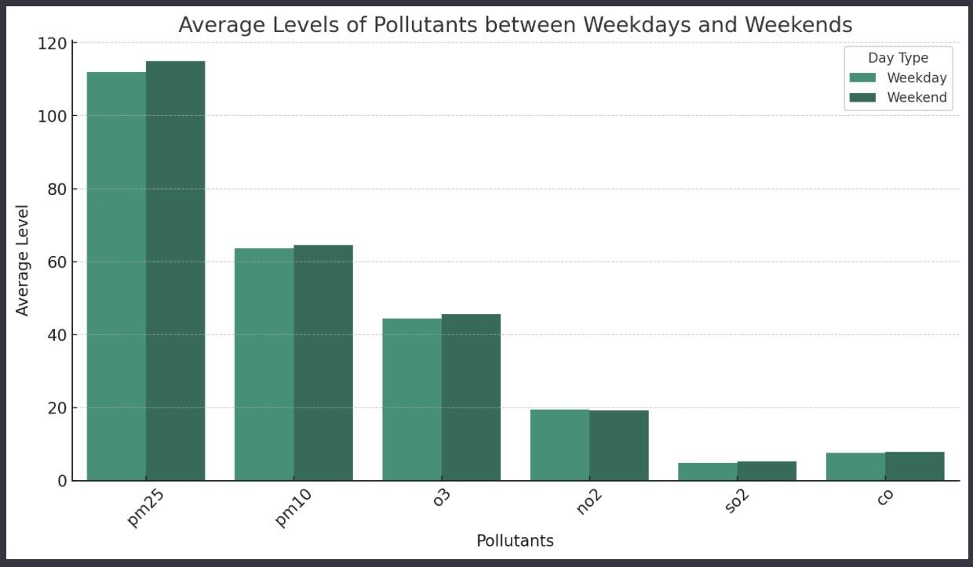
Average Levels of Pollutants between Weekdays and Weekends

